Slide 1
E-Safety A guide for parents and carers

Slide 2
A positive message!
Technology is a GOOD thing!
Access to technology is becoming a major factor in educational attainment.
We are preparing our children for a world we can not yet imagine.

Slide 3
Article 17 (access to information from the media) Every child has the right to reliable information from a variety of sources, and governments should encourage the media to provide information that children can understand. Governments must help protect children from materials that could harm them.

Slide 4
The Risks

Slide 5
Overarching risks of online use
Privacy/digital footprints
Cyber-bullying
Harmful content/illegal materials
Unwanted contact/grooming
Notes:
The risks to children and young people can be identified in the following four categories:
· Unwanted contact/grooming – this is where adults proactively coerce children to groom them on and offline
· Cyberbullying – bullying between young people and adults
· Harmful content/illegal material – things that children and you people see and sometimes produce that maybe harmful
· Privacy/digital footprints – what they say, post and write online and the ‘digital footprint this leaves

Slide 6
When do we need to start educating about e-safety?

Slide 7
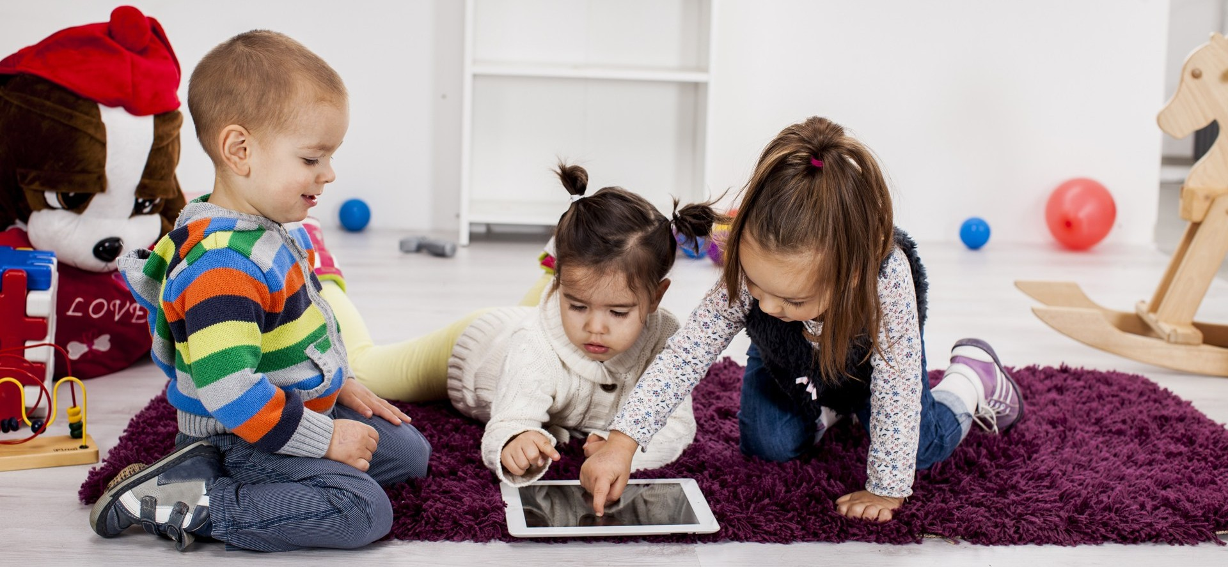

Slide 8
Over half of 3-4 year olds (53%) now regularly use a tablet.
Nearly three-quarters of 5-15s use a tablet.
One in seven 3-4 year olds (15%) and two in five 5-15s (40%) now own their own tablet.

Slide 9
Online footprint

Slide 10
NSPCC

Slide 11
Cyber-bullying
Definition of cyber-bullying:
‘The use of digital technology (text messaging, email, social networking sites etc) to bully, harass or abuse someone.’
(DfE 2009)
How:
Mobiles
Social networking sites
Gaming
Taking and distributing images or videos without permission.

Slide 12
Unwanted contact and grooming
Definition of grooming:
A process by which a person prepares a child, significant others and the environment for the abuse of this child.
Specific goals include gaining access to the child, gaining the child’s compliance and maintaining the child’s secrecy to avoid disclosure
(Craven, Brrown and Gilchrist, 2006)

Slide 13
Harmful Content/illegal materials.

Slide 14
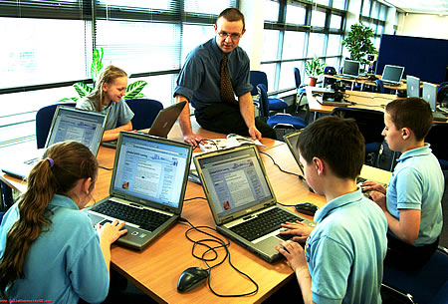
At School……. At home…………
Filtered ?
Supervised ?
Monitored ?
Curriculum ?

Slide 15
Filtering
A potentially clumsy analogy…

Slide 16
What does the school do?
Education – a variety of age-appropriate resources.
E-Safety in the computing curriculum. Digital Literacy programmes.
Across the curriculum – PSHE, English, Deaf Studies…
E-safety goes under the wider umbrella of the Rights Respecting Charters each class is signed up to.

Slide 17
Alongside this…..
E-Safety policy
Acceptable use policy
PSP/iPad Policy
Staff training
Parents information

Slide 18
The key
Supervising, monitoring and talking.
Fewer children now have tvs and consoles in their bedrooms since 2014 (Ofcom)
Parents are aware of the need for good monitoring

Slide 19
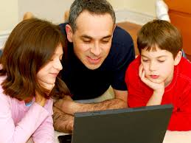
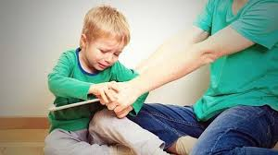
Working together with your child….
Be involved with your child’s online life
Be familiar with the technology, built in safeguards
Agree the types of content that are acceptable to upload and download.
Encourage balanced use, limit time, meal times, bed time…
Agreed areas in the house to use online devices.

Slide 20
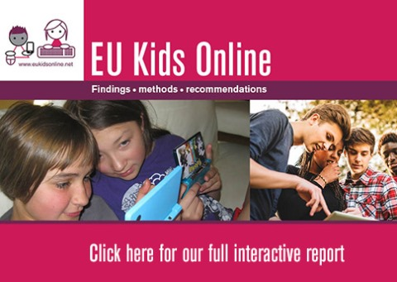

Slide 21
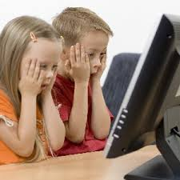
What to do if you are worried…
Capture any evidence
Screenshots, save conversations
Report it
School, Service Provider, Police, CEOP(Child Exploitation and Online Protection Centre)
Use the safety features and tools
Child Accounts, Parental controls, Privacy features in Social Networking
Be alert
Changes in behaviour, secretive, vague about use

Slide 22
Report to......
Report to
Support from
Notes:
CEOP offers direct advice and support to professionals and directly to young people and it also offers the a reporting system. Young people, parents, carers and professionals can report concerns about potential grooming,child sex offender activity and online sexual contact with children and young people directly to CEOP by clicking on the ‘CEOP Report button’. Young people over 11 should be encouraged to report to CEOP if anyone is making them feel uncomfortable online, this may be pressurising them to meet up, sexual chat or sharing sexual images. The key is if someone is making them feel uncomfortable or unsafe online in this way they should report to CEOP.Though CEOP takes reports from children of any age, children under 11 should be encouraged to speak to an adult they trust who can help them fill out the CEOP reporting form. NSPCC’s Childline allows young people to access direct support from a counsellor; Beatbullying’s cybermentors offers advice to children and young people on bullying, cyberbullying and other well being issues. Young people can access trained mentors of their own age for support and advice through www.cybermentors.org.uk. The internet watch foundation www.iwf.org.uk is the UK’s hotline for reporting child abuse images online.. Children and young people should be encouraged to report to the appropriate place and if they are in severe danger they should call 999.

Slide 23
Minimum age limits for Social Networking sites….
Looking at the pictures on your table – do you know the age restrictions on signing up to any of those apps or sites?
NCPCC – Net Aware

Slide 24
CEOP
Notes:
The internet knows no borders and to ensure an international response to online sexual exploitation CEOP are part of the Virtual Global Taskforce - The VGT brings together law enforcement agencies from all over the world to tackle the issues of child abuse and how the internet facilitates this. They aim to provide a 24 hour police presence online, this involves replying to reports received if a child is in immediate danger and working together on joint operations. Countries involved are America, Canada, Australia, Italy, UK (represented by CEOP) and Interpol. There are also a number of countries looking to join.

Slide 25
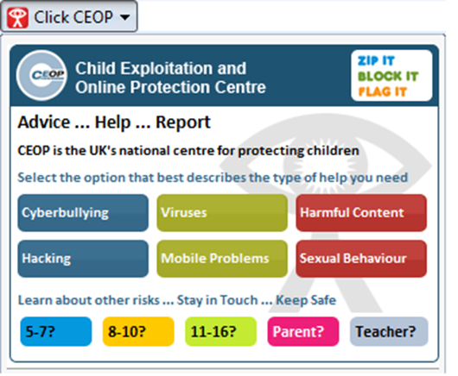
You might see them on some websites….

Slide 26
A positive end-note.
Children in the UK are far less likely to be the victims of online grooming and cyber bullying than other European countries.
Children in the UK are more likely to be supervised.
Children in the UK are more likely to have parental controls on their devices.
Why? Because e-safety education within the curriculum is a priority and parental awareness of issues is high.
(LSE EU Kids Online project)

Slide 27
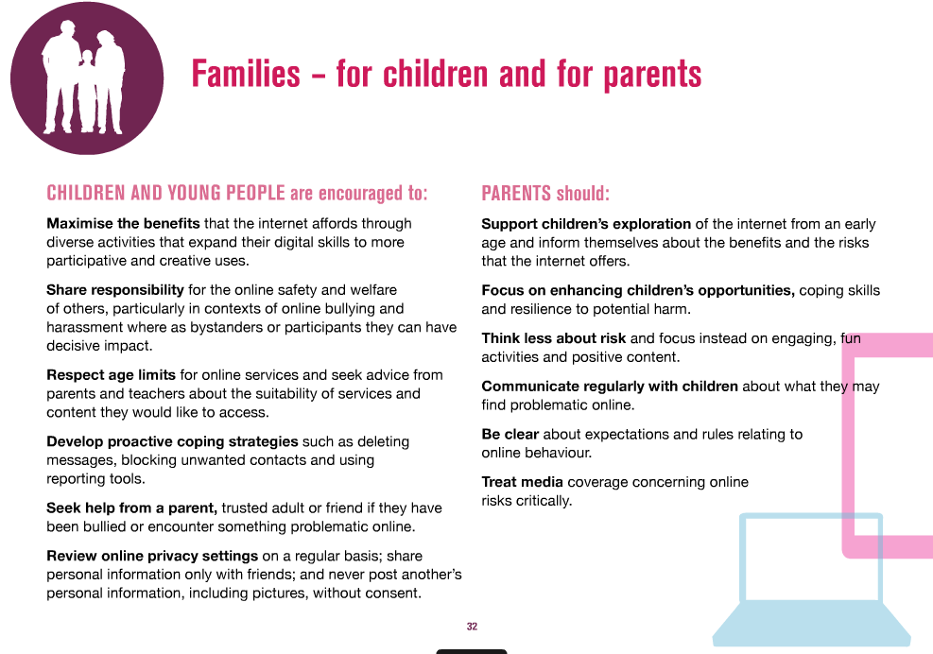

Slide 28
Any Questions?

